Slide 1
Welcome back!

Slide 2
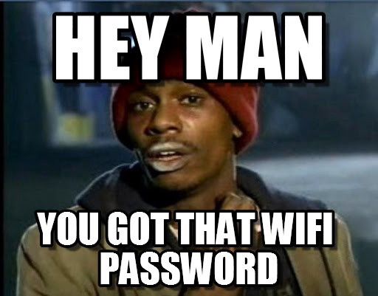

Slide 3
Today’s schedule
Introduction (10am)
GitHub
User interface creation
Lunch (~12pm)
All things API (1:30pm)
Closing (4:30pm)

Slide 4
Tomorrow’s schedule
Introduction 10am
Deployment
Unit testing
Lunch (~12pm)
Accessibility(1:30pm)
Authentication
Expectations on other advanced features. (3:30pm)
Assessment briefing / Imagine Cup
Closing (4:00pm)

Slide 5
Assessment
17th August 2019
You must pass the in-person assessment to get placement
We assess both your technical skills and your soft skills.
We will release the criteria tomorrow.
Do NOT plagiarise
You will book your interview time, we will share the link tomorrow.
Notes:
Will be theory related questions in regard to all the features you have used and all those that you were expected to use.

Slide 6
Imagine Cup
All MSA students get direct entry to the Imagine Cup
We will share more details with you at the soft skills event.

Slide 7
FAQs
You can pull out of placement until Assessment Day
You are assessed as a team too – so work well or tell us

Slide 8
Need Help or Advice?
nzmsa@microsoft.com

Slide 9
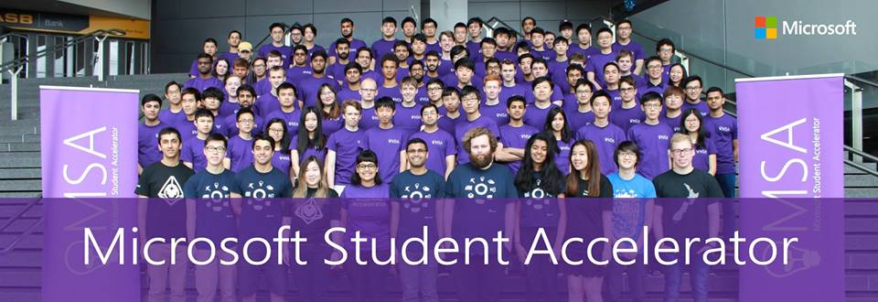
This will be you!
Notes:
Maybe in HD this year though. We will make sure it's at least 1080p

Slide 10
Questions?

